Slide 1
Mo-AI Club Tech Salon
Shared Paper :
Making Sense of Vision and Touch:
Self-Supervised Learning of
Multimodal Representations for Contact-Rich Tasks
Michelle A. Lee, Yuke Zhu, Krishnan Srinivasan, Parth Shah,Silvio Savarese, Li Fei-Fei, Animesh Garg, Jeannette Bohg
Reporter :
Cui Can
College of Control Science & Engineering, Zhejiang University
FACT Lab, Institute of Cyber-System & Control
2019.9.7

Slide 2
Contents
Background Introduction
Multimodal Representation Learning
Design of the Control System
Experience & Performance
Summary

Slide 3
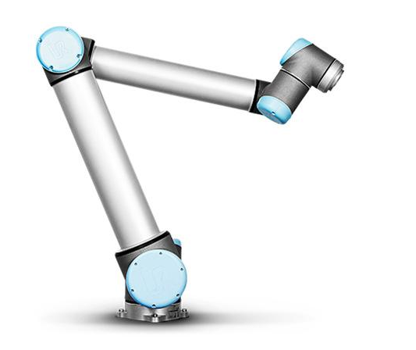
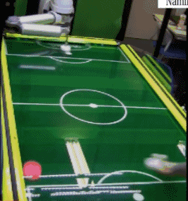
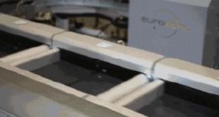
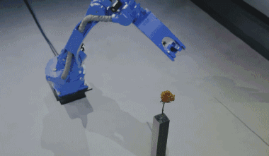
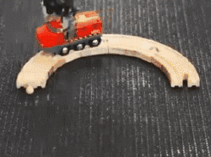
Background Introduction
Robotic Arm: Vision and Touch

Slide 4


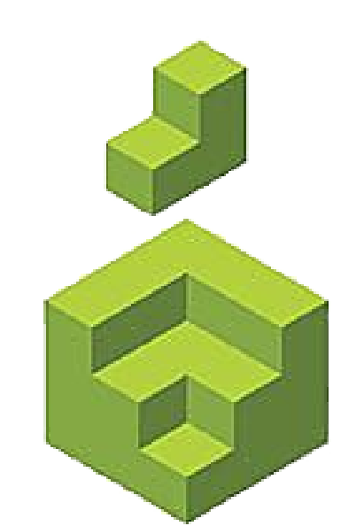
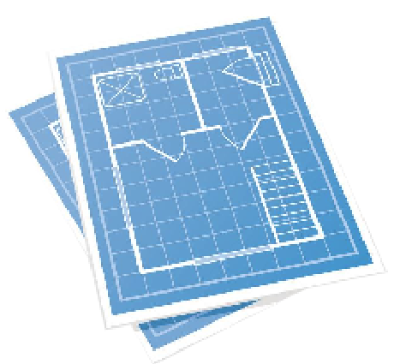

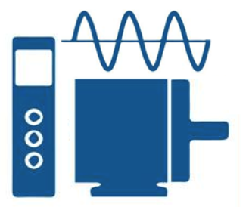


Background Introduction
Classical methods
State Variable Collector
Trajectory Planning
Modeling the System
Design the Controller
Measurement
Low Level Control
State Variable
State Variable
Feedback

Slide 5
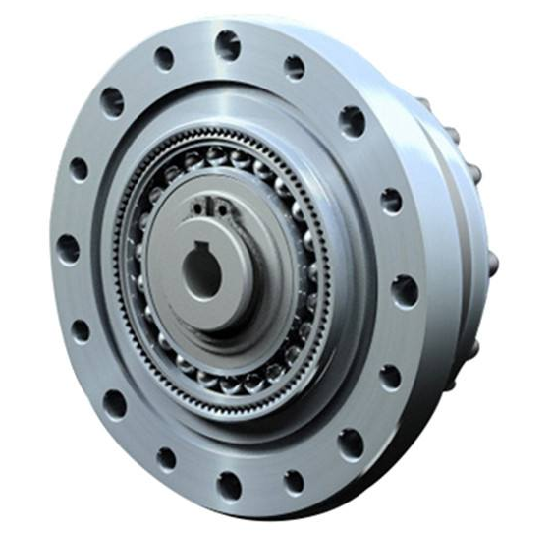
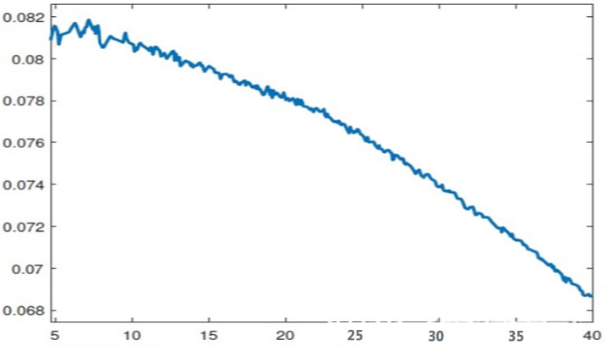
Background Introduction
Problems which can be solved by classical methods
Modeling Error(Deadzone/Nonlinearity/Mismatch)
Measurement Error
Auto Tuning of Controller Parameters

Slide 6

Background Introduction
Capabilities of Classical Methods

Slide 7
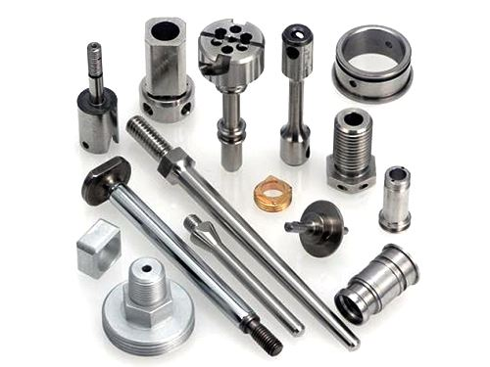

Background Introduction
Why should machine learning be introduced to this field
You CANNOT Model every tsak
modalities with very different characteristics
NEITHER can you measure everything

Slide 8


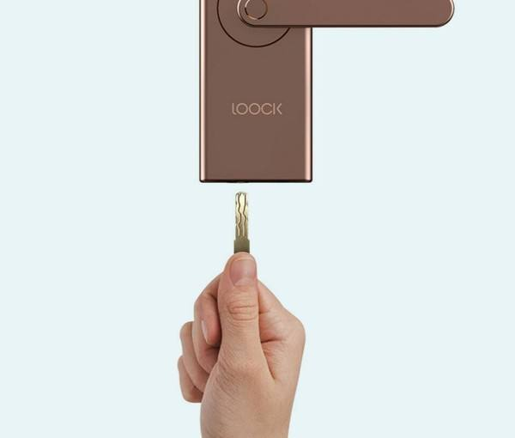
Background Introduction
Why should machine learning be introduced to this field
Vision & Touch
Manual Design
Generate
Trajectory
Vision
Measure
Touch
Automatic
Learning Model

Slide 9
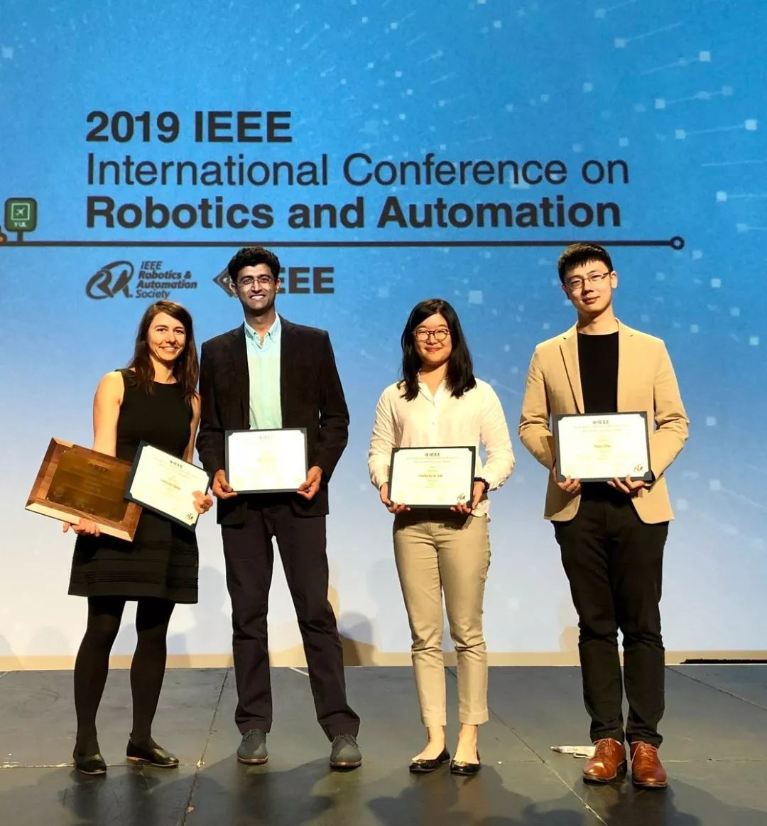
Background Introduction
ICRA 2019 Best Paper
Features:
Multimodal compatibility.
Deploys on real robots
Sample efficient
Robust to external perturbations
Notes:
适用于多种模态
可以用于真正的机械臂（传统强化学习虽然能够处理高维度输入下的策略学习，但由于样本复杂度难以应用于实际场景）
样本效率高

Slide 10
Background Introduction
ICRA 2019 Best Paper
Contribution:
A model for multimodal representation learning from which a contact-rich manipulation policy can be learned.
Demonstration of insertion tasks that effectively utilize both haptic and visual feedback for hole search, peg alignment, and insertion.
Evaluation of generalization to tasks with different peg geometry and of robustness to perturbation and sensor noise.

Slide 11
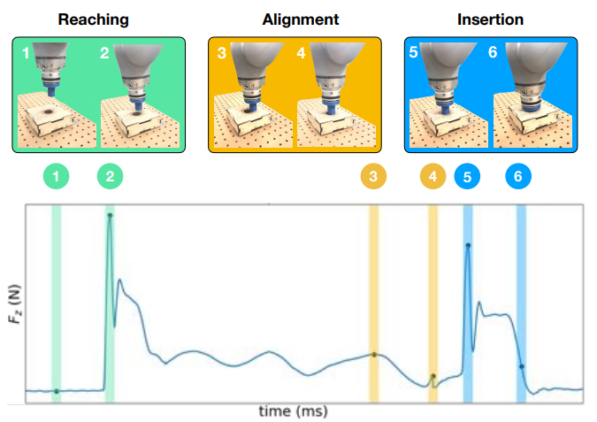
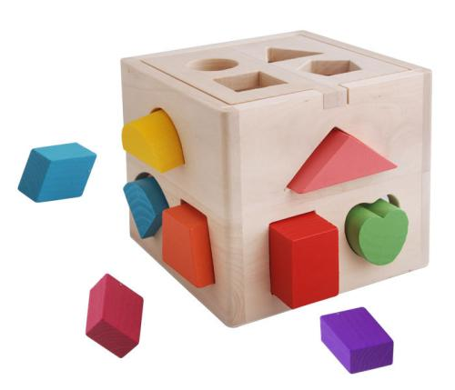
Background Introduction
Task Formulation of Peg Insertion Task
DO NOT
require manual task specification
Visual feedback
Haptic feedback
At very different dimensions, frequencies
Notes:
适用于多种模态
可以用于真正的机械臂（传统强化学习虽然能够处理高维度输入下的策略学习，但由于样本复杂度难以应用于实际场景）
样本效率高

Slide 12

Multimodal Representation Learning
Sensor Fusion & Classification Multimodal Representation Learning
Goal：
Evaluate the value of combining multisensory information and the ability to transfer multimodal representations across tasks.
Step：
First learn a neural network-based feature representation of the multisensory data, the resulting compact feature vector serves as input to a policy that is learned through reinforcement learning.

Slide 13
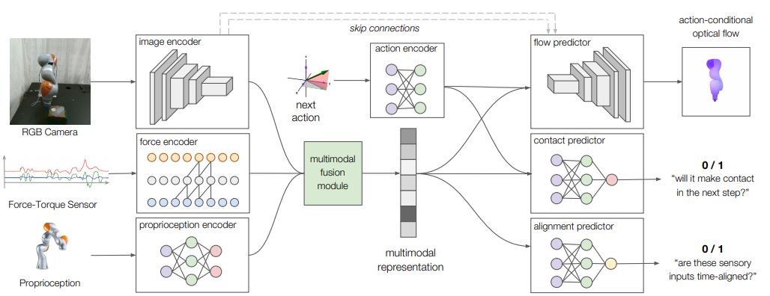
Multimodal Representation Learning
Multimodal Representation Model
Seeking sources of supervision that do not rely on laborious human annotation

Slide 14
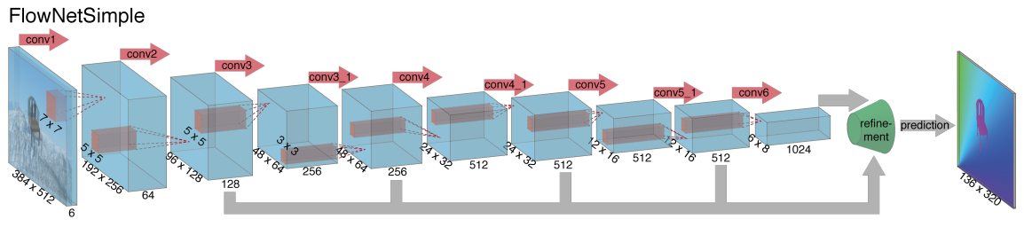
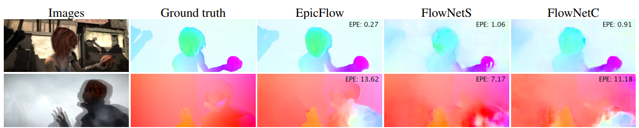
Multimodal Representation Learning
Modality Encoders
RGB images from a fixed camera
6-layer convolutional
neural network (CNN)
Similar to FlowNet
128×128×3 RGB images
1FC Layer
128-d Feature Vector
Reference：FlowNet: Learning Optical Flow with Convolutional Networks

Slide 15
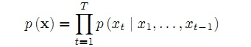

Multimodal Representation Learning
Modality Encoders
Haptic feedback from a wrist-mounted force-torque
(F/T) sensor
perform 5-layer causal convolutions with stride 2
64-d Feature Vector
Last 32 Readings
32 × 6 time series
Sequence modeling. Competitor of LSTM, RNN
Reference：https://deepmind.com/blog/wavenet-generative-model-raw-audio/

Slide 16
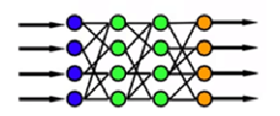
Multimodal Representation Learning
Modality Encoders
Proprioceptive data from the joint encoders of the robot arm
2-layer multilayer perceptron
(MLP)
32-d Feature Vector
Current position and velocity of the end-effector

Slide 17
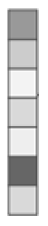
Multimodal Representation Learning
Modality Encoders
128-d Multimodal Representationr
RGB images
128-d Feature Vector
Multimodal fusion module (2-layer MLP)
Haptic feedback
64-d Feature Vector
32-d Feature Vector
Proprioceptive data

Slide 18
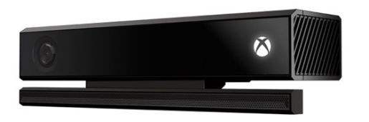
Multimodal Representation Learning
Self-Supervised Predictions
Number of Modality Encoders Parameters: Near 50,0000
Representations for control should also encode the action-related information
Two action-conditional representation learning objectives
Model Has to Make Three Prediction
Based on
What is the optical flow generated by the action?
Will it make contact?
Are these sensory inputs time aligned?
Encoded Acition Information
Encoded multimodal Information

Slide 19



Multimodal Representation Learning
Trained by action-conditional optical flow with endpoint
error (EPE) loss averaged over all pixels
Self-Supervised Predictions
6-layer convolutional contact predictor with upsampling, use 4 skip connections with encoder
Flow map of size 128 × 128 × 2
2-layer multilayer perceptron
(MLP)
The next action
2-layer MLP contact
predictor, which performs binary classification
128-d Multimodal Representationr
True/False
Trained by cross-entropy loss
2-layer MLP alignment predictor, which performs binary classification
True/False
Trained by aligned data and random shifted data
(cross-entropy loss)

Slide 20
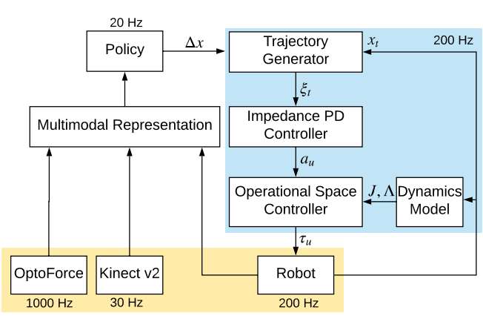
Design of the Control System
Controller takes end-effector position displacements from the policy at 20Hz and outputs robot torque commands at 200Hz. The trajectory generator interpolates high-bandwidth robot trajectories from low-bandwidth policy actions. The impedance PD controller tracks the interpolated trajectory.

Slide 21
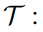
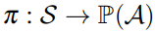
Design of the Control System
Reinforcement Learning of the task
Presumption：Finite-horizon Markov Decision Process (MDP)
with State space
Action space
State transition dynamics
Initial state distribution
Reward function(single step)
Discount factor
Time horizon
Stochastic policy

Slide 22
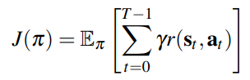
Design of the Control System
Reward Design
Policy
With parameters
is defined by the low-dimensional representation learned from highdimensional visual and haptic sensory data
is defined over continuously-valued, 3D displacements ∆x in Cartesian space.

Slide 23
Design of the Control System
Policy Learning
Model-free reinforcement learning under uncertainty in geometry, clearance and configuration
Trust-region policy optimization (TRPO)
Policy Network
128-d multimodal representation
3D displacement ∆x of the robot end-effector
2-layer MLP
Note：representation model parameters are freezed during policy

Slide 24
Design of the Control System
Controller Design
Policy outputs Cartesian control commands instead of joint-space commands, so it does not need to implicitly learn the non-linear and redundant mapping between 7-DoF joint space and 3-DoF Cartesian space
Direct torque control
Compliance & Safety
The robot can slide on the surface of the box while pushing downwards
Makes the peg insertion task easier to accomplish under position uncertainty

Slide 25
Design of the Control System
Trajectory generator
Trajectory generator
Bridge
low-bandwidth output
20Hz
High-bandwidth torque control
200Hz
Robot
Policy Network
Given from the policy and the current end-effector position
Calculate the desired end-effector position
Interpolates between and ，generate trajectory at 200Hz
PD impedance controller
is the inertial matrix of the robot
is the Jacobian matrix（function of joint angle )

Slide 26
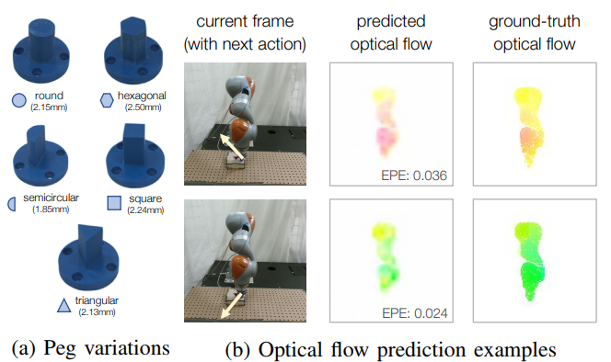
Experience & Performance
Examine the effectiveness of the multimodal representations
Task Setup
7 DoF Kuka LBR IIWA robot
RGB camera
OptoForce Force-torque sensor feature:
6-axis feedback on the forces and moments
proprioceptive feature:
End-effector pose, linear and angular velocity
9DoF computed using forward kinematics
Kinect v2 camera as groundtruth
CHAI3D for simulation rendering
SAI 2.0 physics engine for simulation

Slide 27
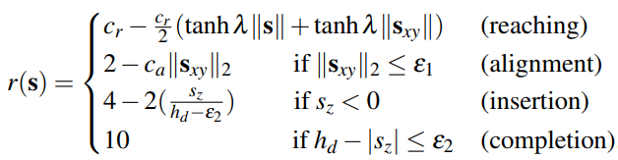
Experience & Performance
Reward Function
Peg's current position
a constant factor to scale input
constant factors
hole depth

Slide 28
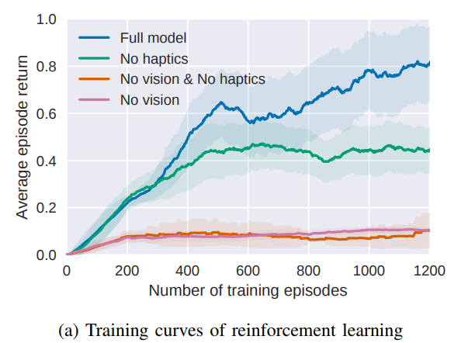
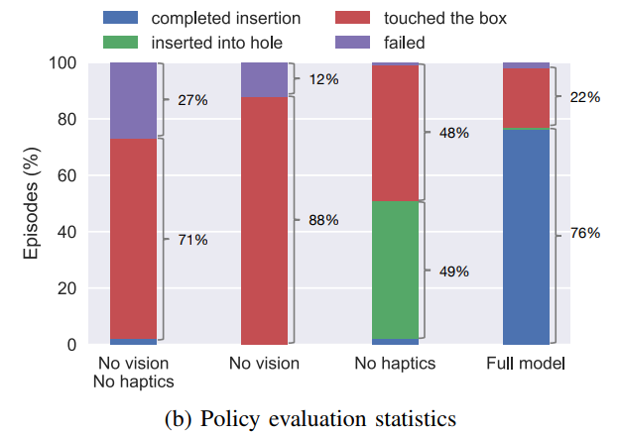
Experience & Performance
Train all policies with 1.2k episodes, each lasting
500 steps. We evaluate 10 trials with the stochastic policy
every 10 training episodes.
Simulated Peg Insertion
All baseline methods have a completion rate below 5%

Slide 29
Experience & Performance
Real Robot Results
Multimodal dataset of 100k states and generate the self-supervised annotations.
Roll out a random policy as well as a heuristic policy while collecting the data, which encourages the peg to make contact with the box.
It takes 90 to 120 minutes to collect the data.
The representation models are trained for 20 epochs on a Titan V GPU before starting policy learning.

Slide 30
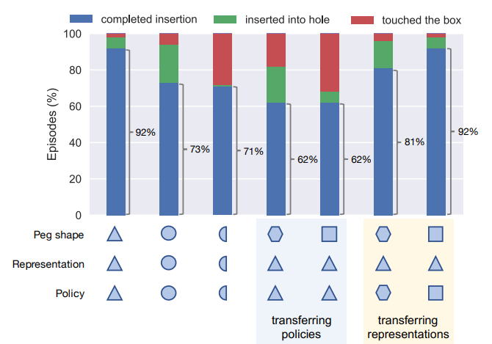
Experience & Performance
Real Robot Results
Train the TRPO policies for 300 episodes, each lasting 1000 steps, roughly 5 hours of wall-clock time. We evaluate each policy for 100 episodes.
The first three bars correspond to the set of experiments where a specific
representation model and policy for each type of peg is trained.
For policy transfer, we take the representation model and the policy trained for the triangular peg, and execute with the new pegs.

Slide 31
Summary
Slove the problem of multimodal representation
Compatible of Transferring
Sample Efficient

Slide 32
Summary
Policy Learning & Controller Design
Deep reinforcement learning with TRPO
Robust to external perturbations
Can be deployed on real robots

Slide 33
Summary
Contribution
A model for multimodal representation learning from which a contact-rich manipulation policy can be learned.
Demonstration of insertion tasks that effectively utilize both haptic and visual feedback for hole search, peg alignment, and insertion. Ablative studies compare the effects of each modality on task performance.
Evaluation of generalization to tasks with different peg geometry and of robustness to perturbation and sensor noise.

Slide 34
Summary
Limitations
Lack of explainability. Design of the multi-modal representation network.
Unproved Stability.

Slide 35
The End
Thank you for your attention！

